Slide 1

DUOday in Lithuania

Slide 2



Our DUODAY Journey
2019
Pilot project
2021
2022
12 cities
2023
2024
2025
Only SOPA
7 cities
Only Vilnius
SOPA + 6 partners
13 organizations
18 cities
25 organizations
20 cities
24 organizations
20 cities
29 organizations
32 people
25 companies
152 people
82 companies
119 peple
80 companies
270 people
150 companies
260 people
134 companies
284 people
160 companies
32 DUO
355 DUO
405 DUO
419 DUO
201 DUO

Slide 3
What we DO / dual role
SOPA
Partners
Employers
People with disabilities
People with disabilities
Employers
SOPA – national coordinator
Initiating the Duoday campaign
Setting timelines and key deadlines
Attracting and engaging local partners
Training and supporting regional partners
Promoting the initiativ
SOPA – sending organisations:
Participant preparation
Employer preparation
Matching

Slide 4
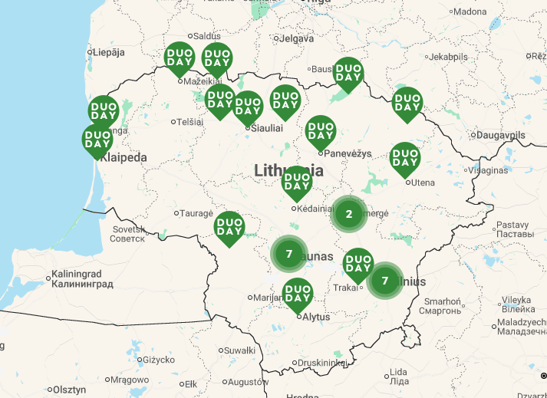
Current Situation/ 2025
20 locations
29 organizations

Slide 5
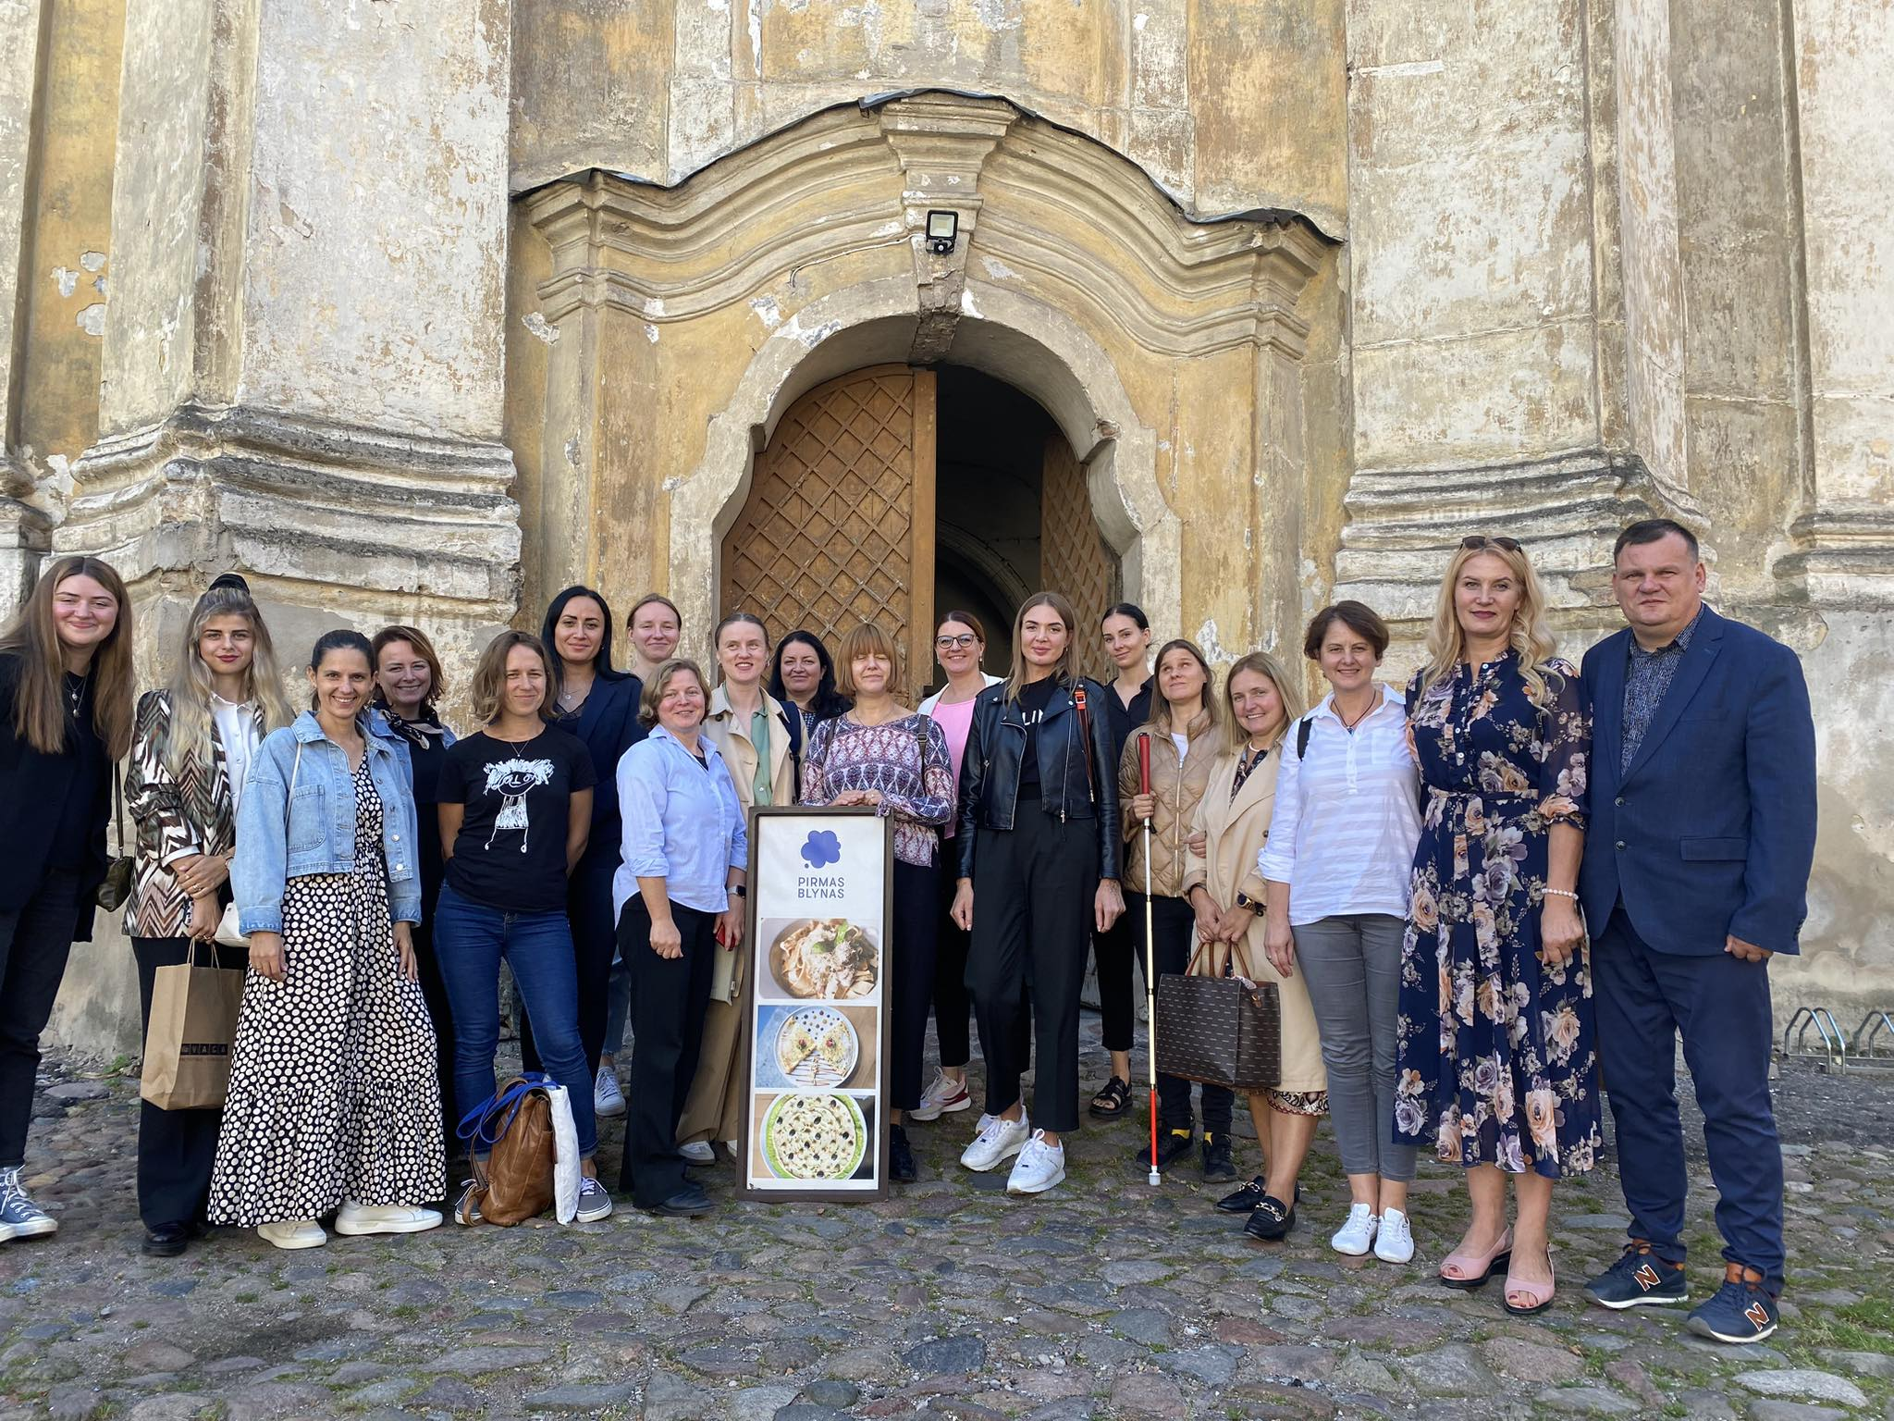
Local partnerships
13 NGO
working with people with autism, visual impairments, intelectual disabilities, hearing impairments
2 schools
Vocational and special education
14 social service institutions
day care centres, social service centres, municipalities

Slide 6
Working with Regional partners
Registration
Duoday.lt
Individual interview (for new one)
Online meeting – clarification of responsibilities
Preparation
Manual – written guidelines on how to organise DUOday localy
Implementation
Individual consultation and guidance
After
Monthly online meetings
Trainings
Common shared database (google sheets)
Sharing contacts
Calculations of results
Feedback questionnaires
Certificates for social workers( if needed)
Adding to the map
Brandbook
deadlines
Success stories (social media, web)

