Slide 1

DUOday in Lithuania

Slide 2
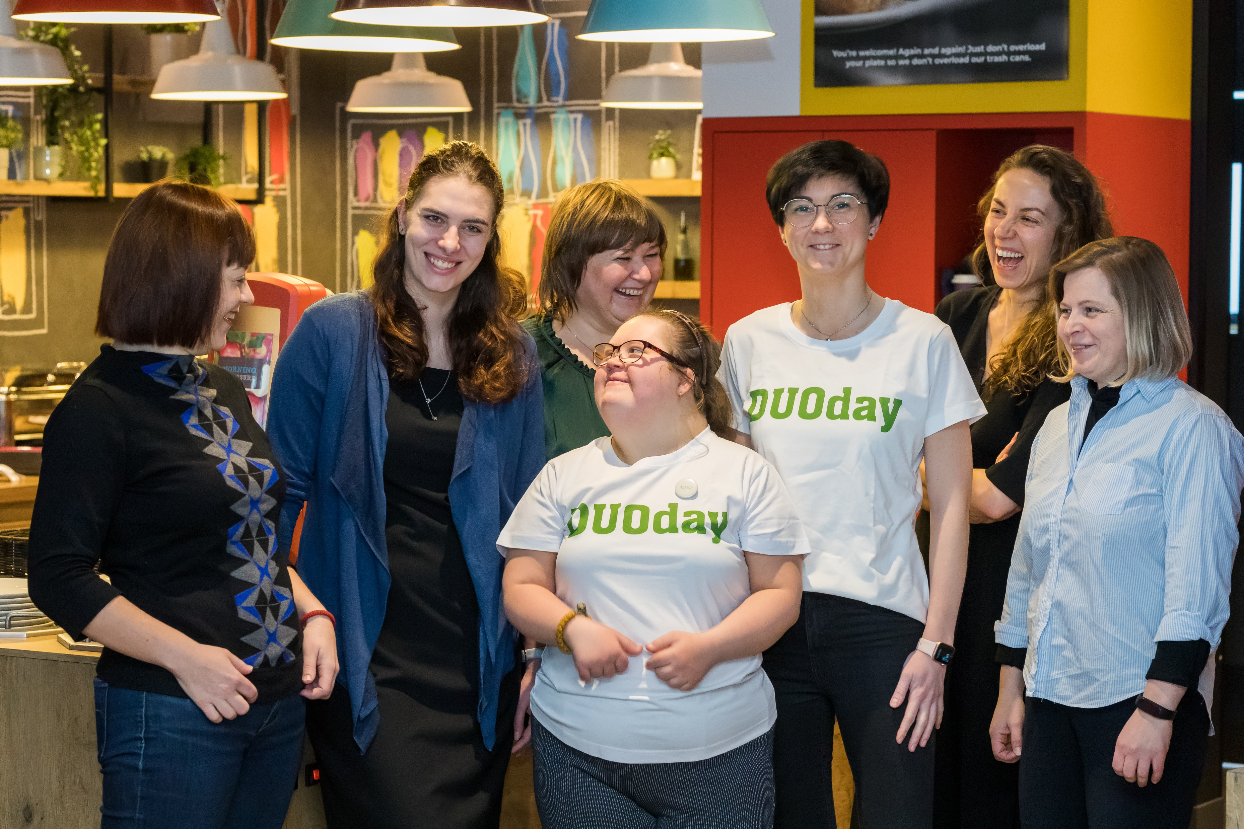
Preparing paRTICIPANTS
Our main goal
is to find suitable DUOday placements for every client who is receiving our services

Slide 3
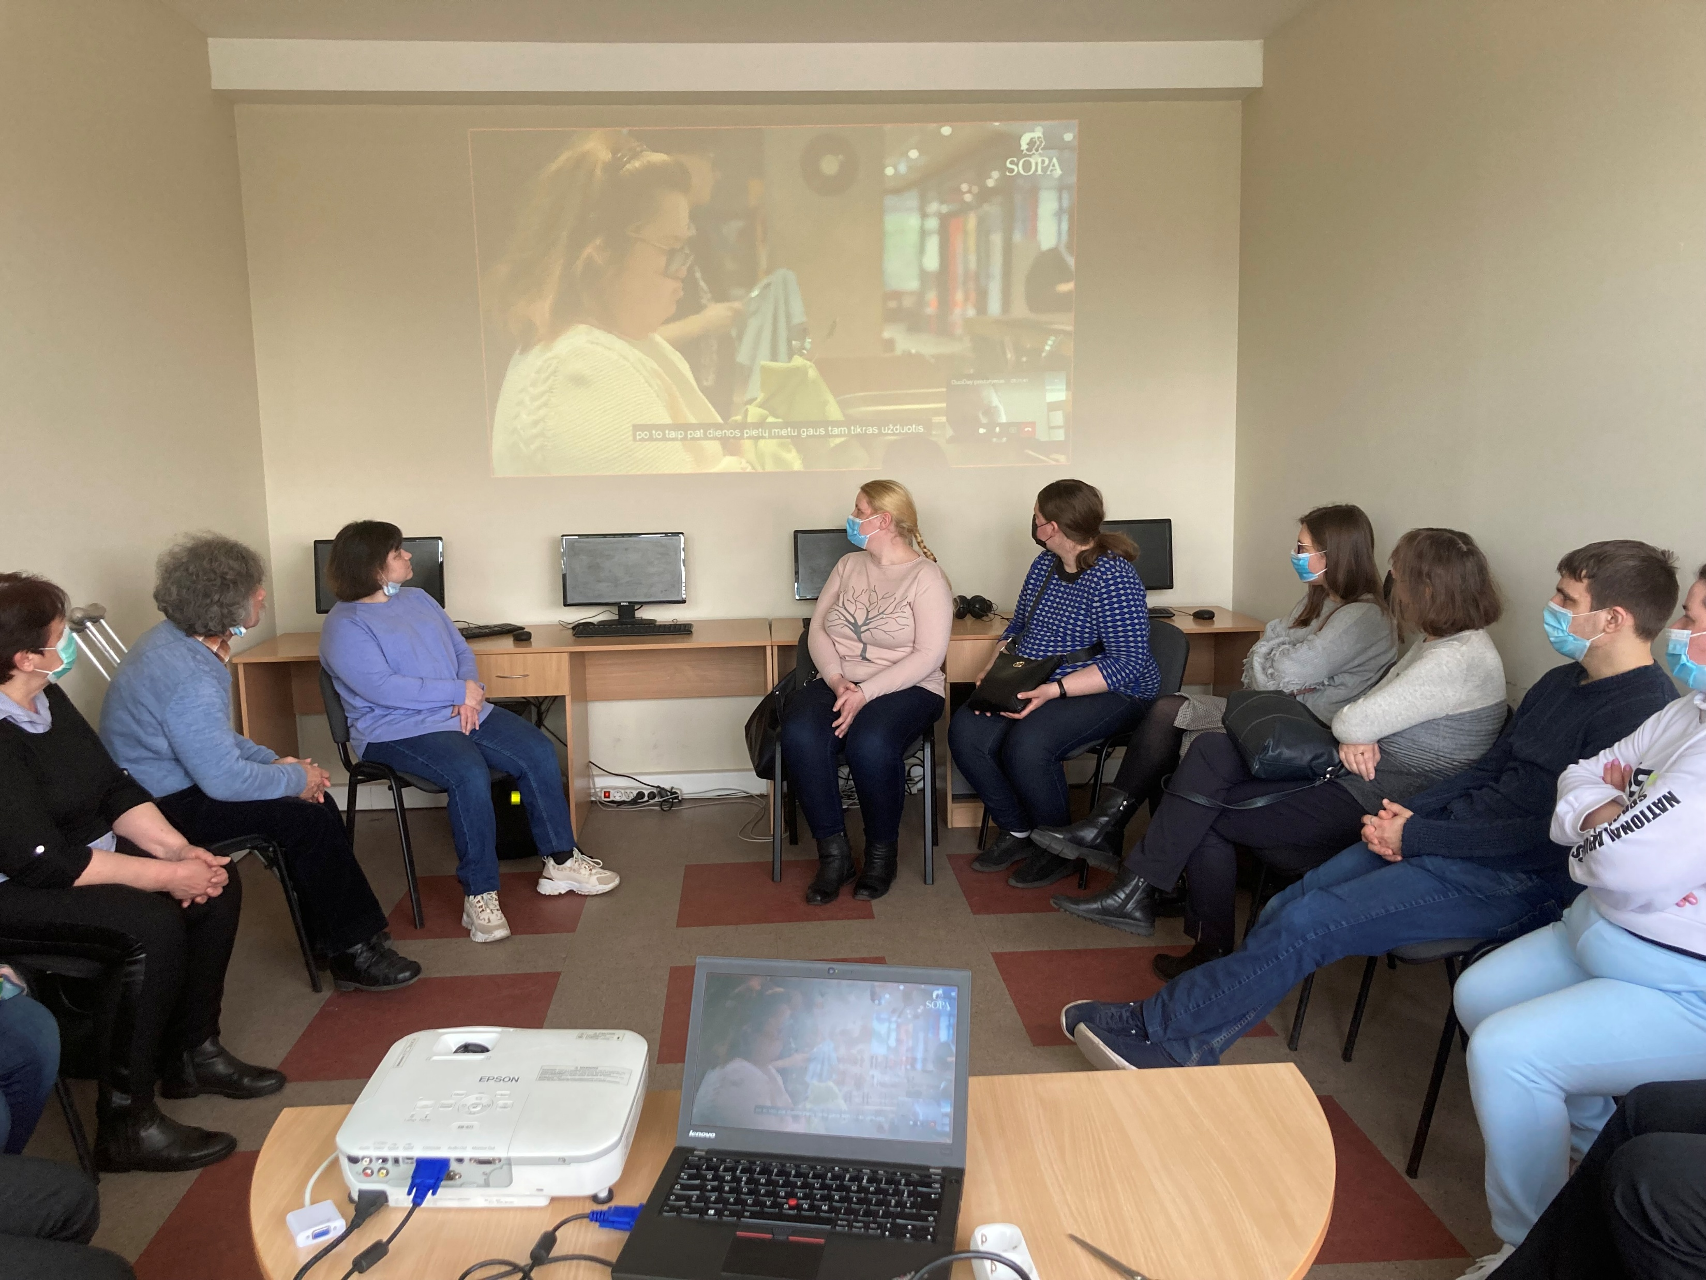
Group workshops
To inform, inspire and encourage participants to take part in DUOday
We inform participants about the DUOday initiative and explain the concept of job shadowing
We highlight the benefits of participation
We share success stories from previous years to boost confidence and motivations
We invite past participants to share their personal experiences
We present the companies involved in DUOday

Slide 4
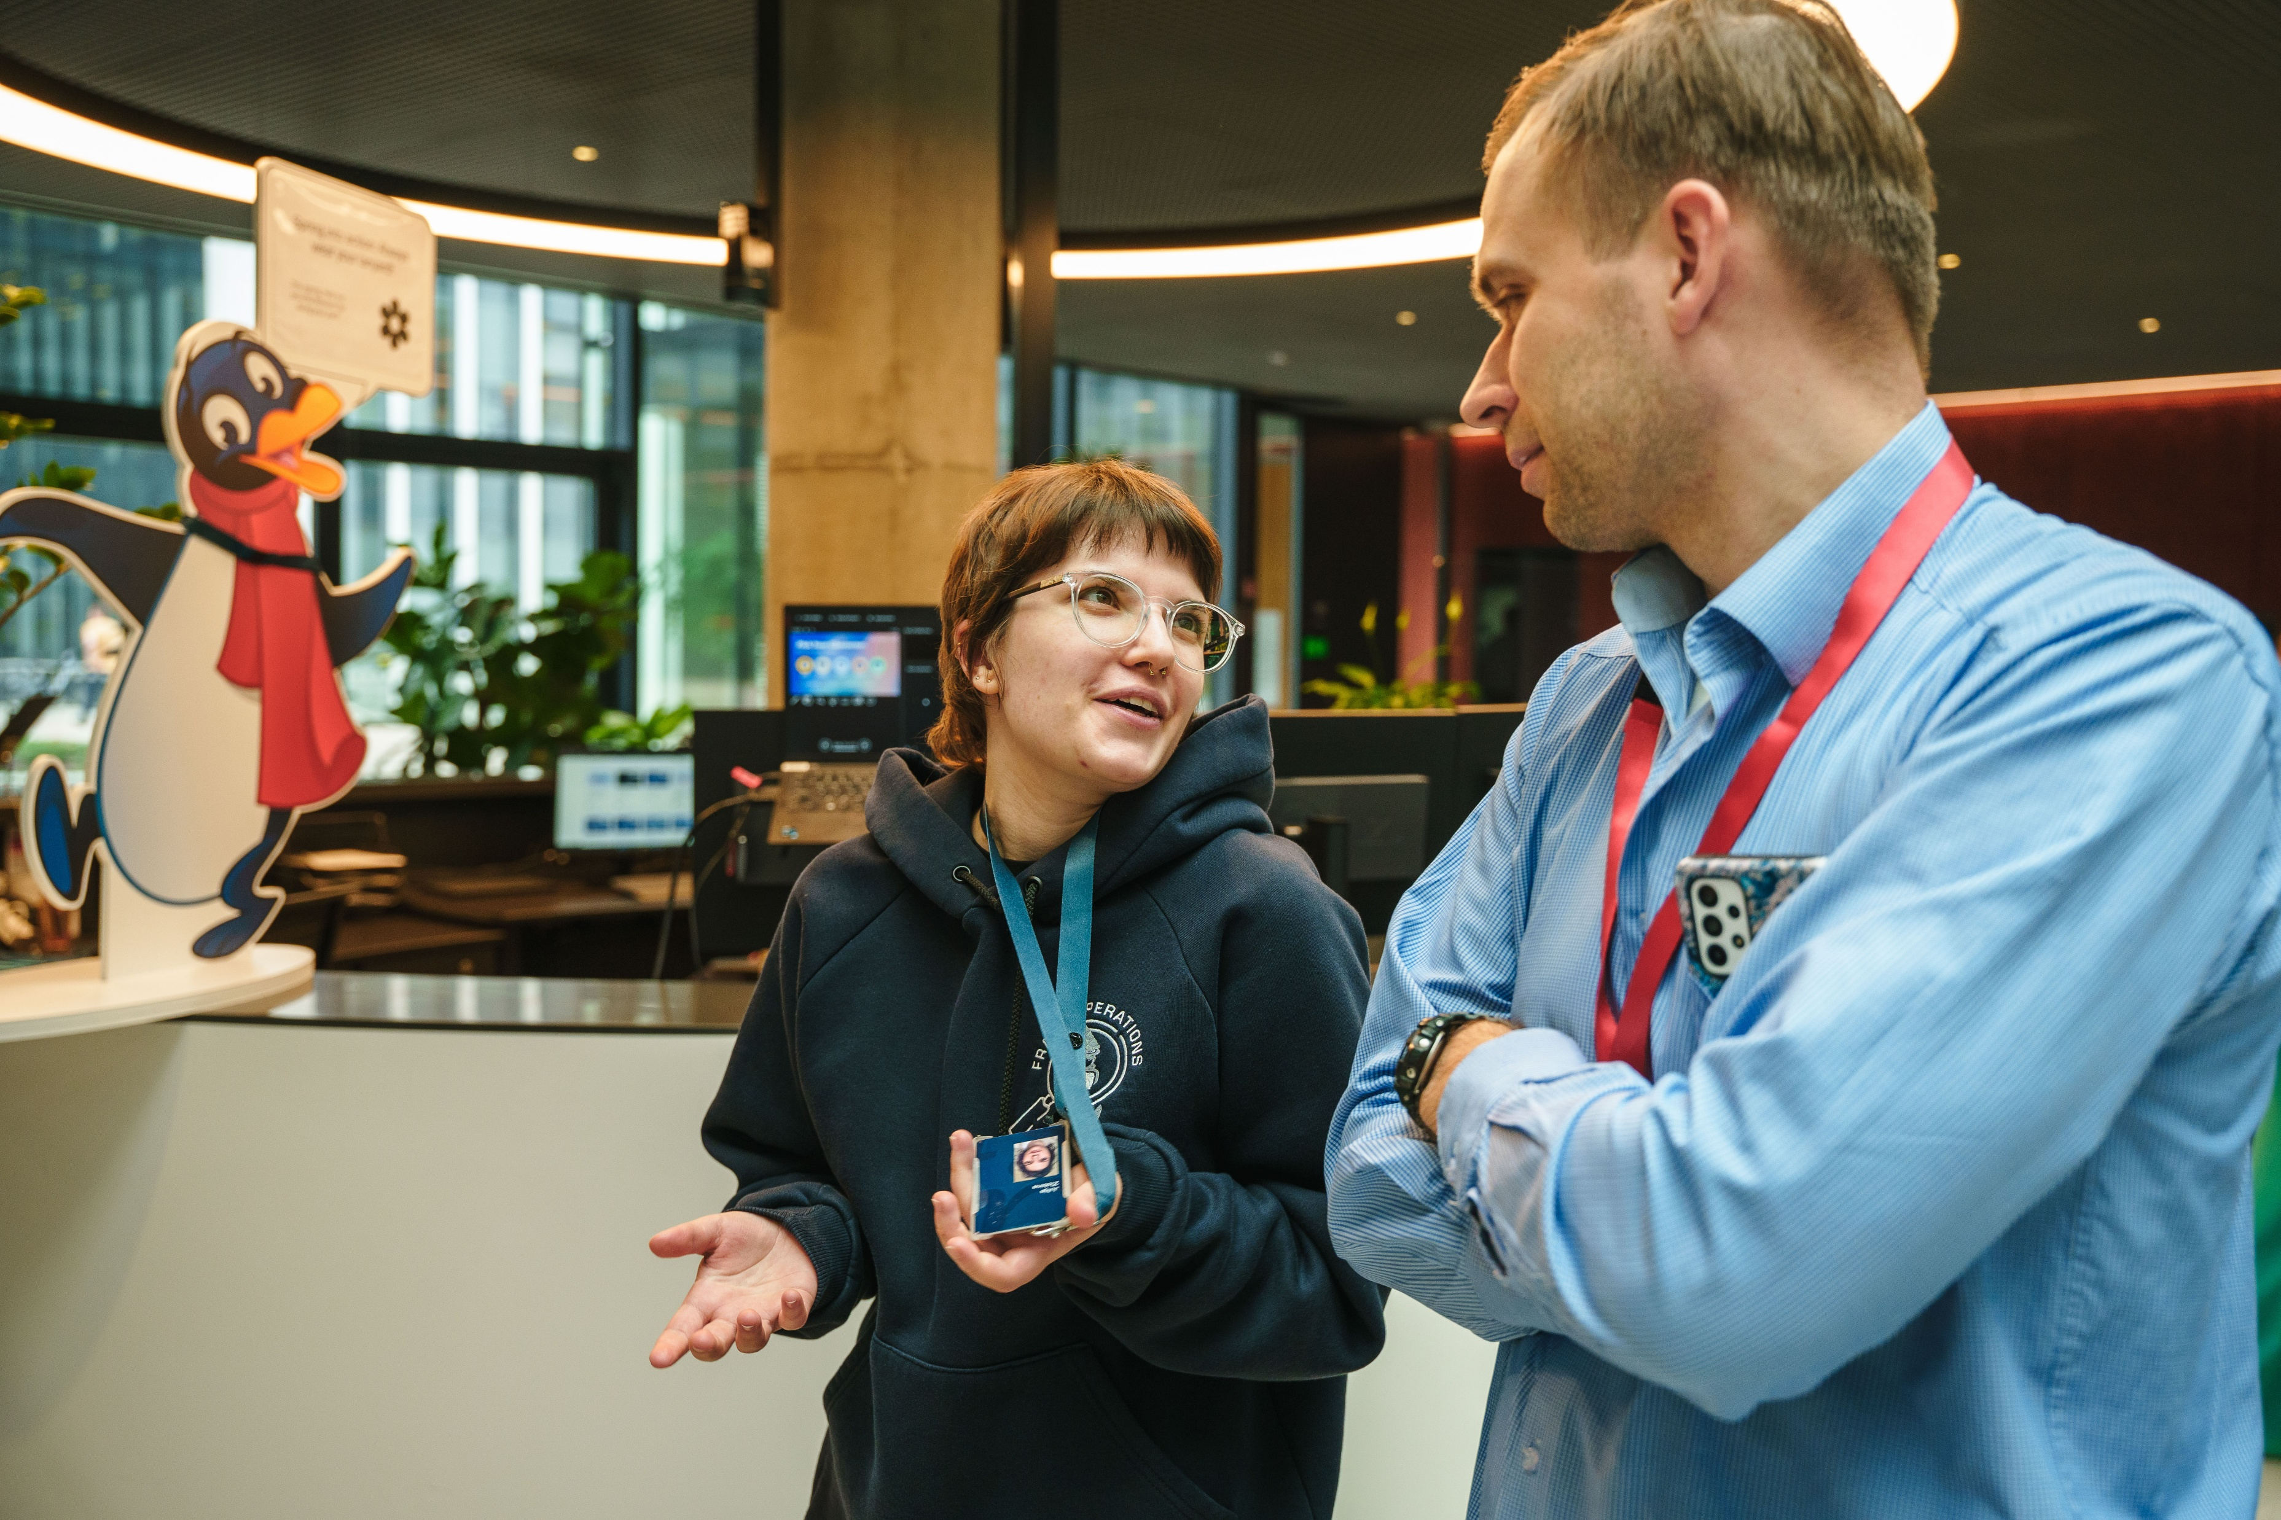
Individual consultations
One to one support and coaching better to unterstand each participant‘s
Skills
Interests
Needs

Slide 5
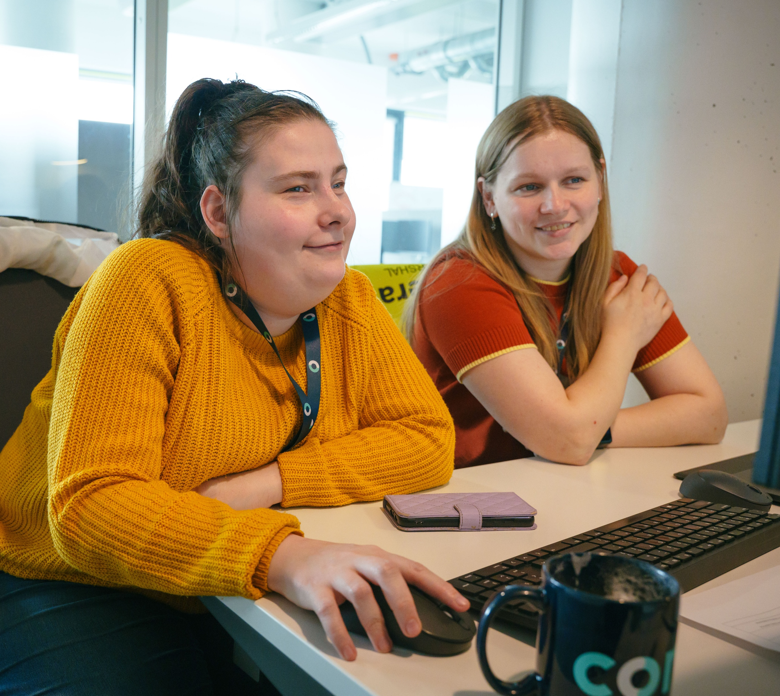
matching
Individual approach
Compare participant profiles with available placements
Possibility to take part in DUOday more than once
Excel matching tool

Slide 6
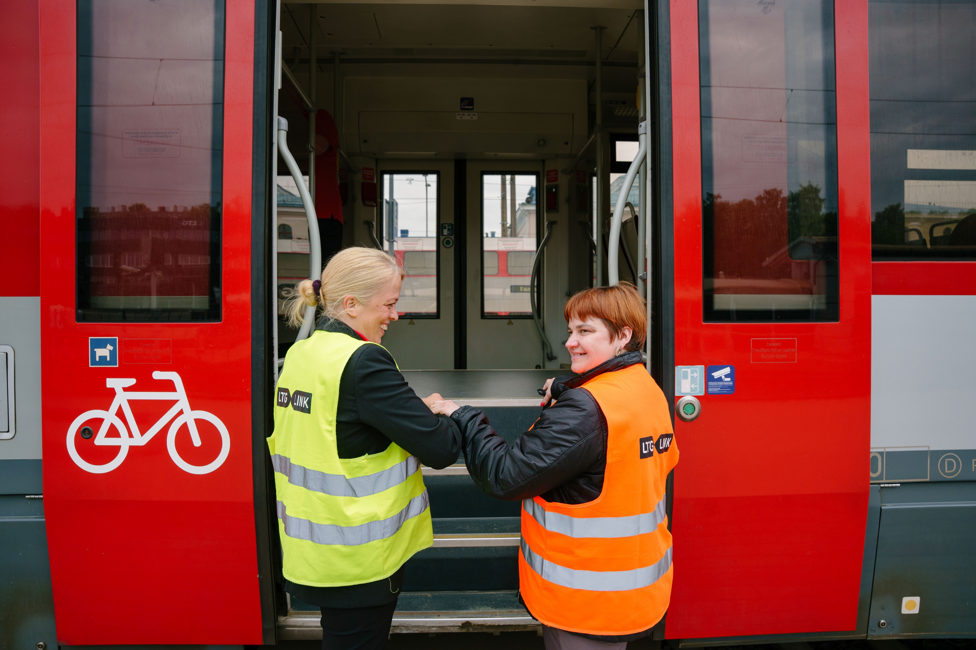
Logistics
Participants are informed in advance about how to get to the company – including the address, transportation options, and estimated travel time.
If needed, we personally accompany participants to their placement locations.

Slide 7
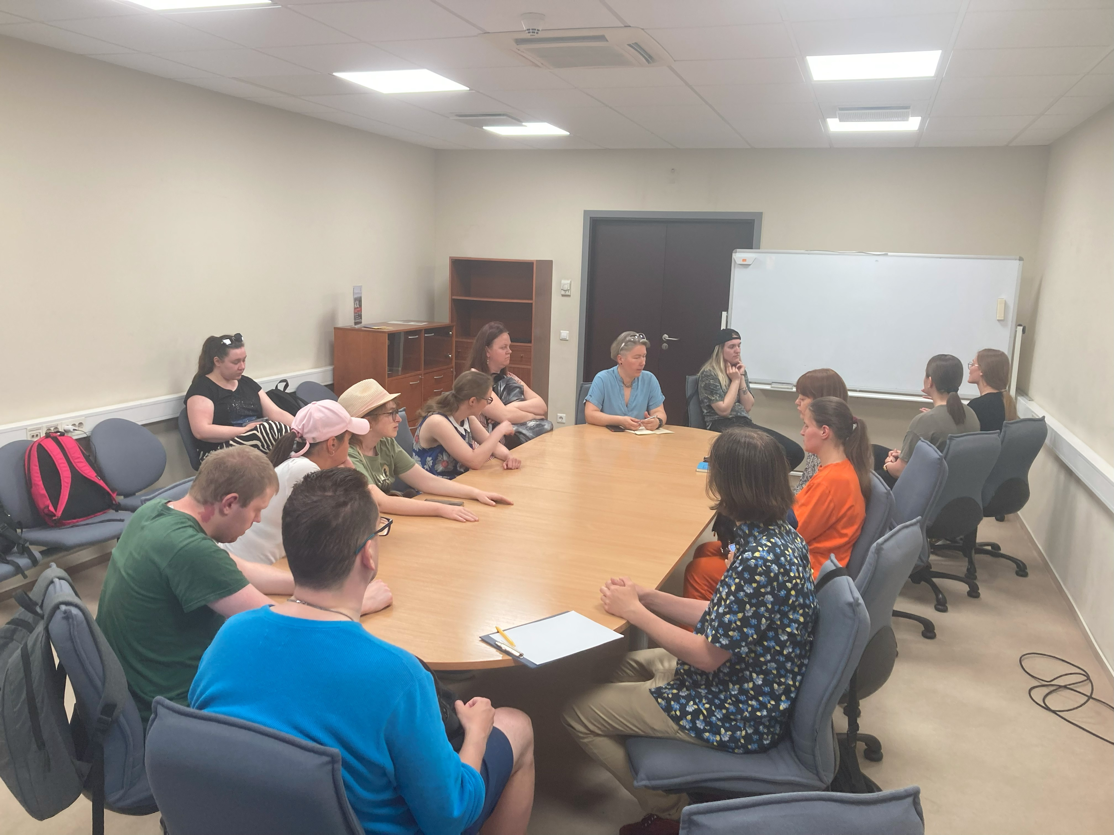
AFTER
Collecting Feedback ( questionnaires)
How they felt during the day
What tasks they tried
What they liked and what could be improved
Sharing Experiences ( group reflection sessions – open discussion)

Slide 8
Results/2025
130 Duo‘s
35 people
3 got employed
59 companies

